Slide 1

Smart Farmer Advisory System
Industrial Training Presentation
AI Powered Crop Price Prediction & Market Analytics
Presented By –
Name :- Aksh Kantiwal
Roll No.:-24ESKCA018
Submitted To:
Name :- Neha Mathur
Assistant Professor
Department of Computer Science & Engineering (AI)

Slide 2
INDEX
1.Company Introduction
2.Internship Overview
3.Technology Stack
4.Problem Statement
5.Project Objectives
6.Project Execution Flow
7.Machine Learning Model
8.Dashboard Overview
9.AI Price Prediction
10.Market Analytics
11.Market Records
12.Future Scope
13.Questions & Discussion

Slide 3

Company Introduction
🏢 Code Connect Pvt. Ltd. is a Jaipur-based IT Services & Software Development Company.
💻 Expertise in Artificial Intelligence, Machine Learning, Data Analytics & Python Development.
🌐 Builds modern web applications and intelligent software solutions.
🎯 Delivers industry-oriented training through real-world projects and mentorship.
🚀 Committed to innovation, technical excellence, and practical learning.

Slide 4


Slide 5






Technology Stack
Core Logic
Web Interface
Database
ML Model
Visualization
Version Control

Slide 6
Problem Statement
Farmers struggle to identify the best time and market to sell crops.
Crop prices fluctuate frequently, making selling decisions difficult.
Government agricultural market data is large and difficult to analyze manually.
Limited access to prediction-based market insights.

Slide 7
Project Objectives
🎯 Predict future crop prices using Machine Learning.
📊 Analyze historical agricultural market data.
📈 Identify seasonal price trends and market patterns.
🤖 Generate BUY / SELL / MONITOR recommendations.
💻 Develop an interactive dashboard for decision support.

Slide 8
Project Execution Flow
Government Dataset
(AGMARKNET)
🧹 Data Preprocessing
Data Cleaning Missing
Value Handling
Feature Encoding
🗄 SQLite Database
Store Processed Data
🤖 Random Forest
Future Price Prediction
📊 Analytics
Trend Analysis
Seasonality
Stability Score
🌐 Streamlit Dashboard
👨‍🌾 Farmer / User

Slide 9
Machine Learning Model
Historical Data
Data Preprocessing
Data Preparation
Train / Test Split
Random Forest Regressor
Price Prediction
Algorithm
Random Forest Regressor
Input Features
Commodity
State
District
Market
Variety
Grade
Date
Output
Predicted Modal Price

Slide 10
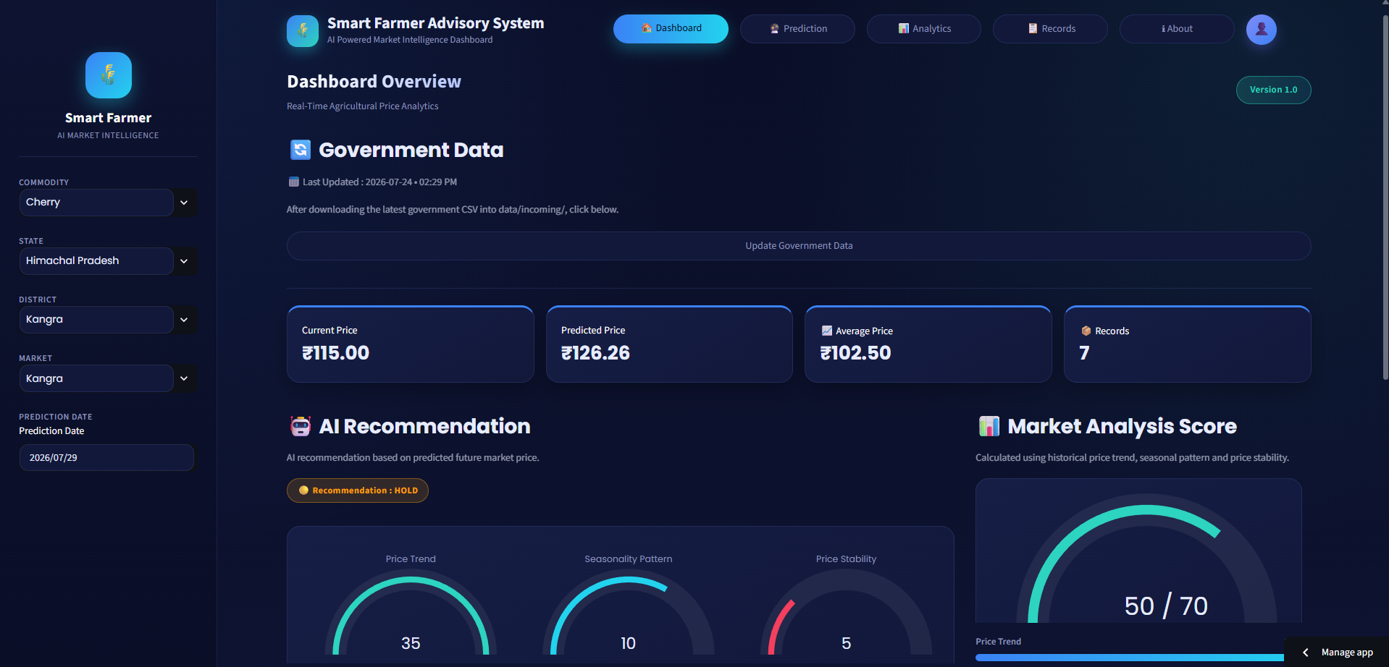
Dashboard Overview
Key Components
📊 Interactive Dashboard 💰 Current & Predicted Price 🎯 AI Recommendation 📈 Market Analytics

Slide 11
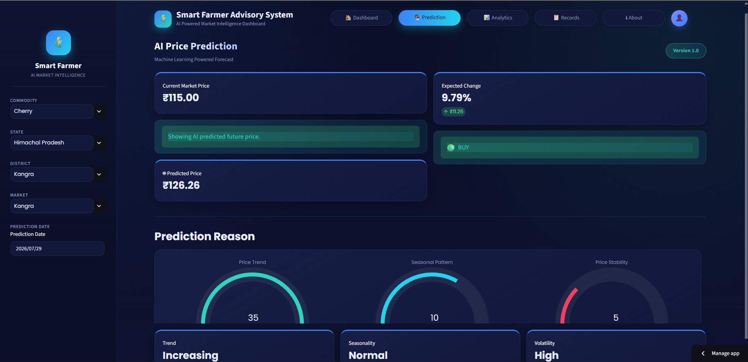
Price Prediction Module
👤 User Input
User selects market details
🤖 AI Prediction
Random Forest predicts future price
💡Recommendation
AI generates recommendation

Slide 12
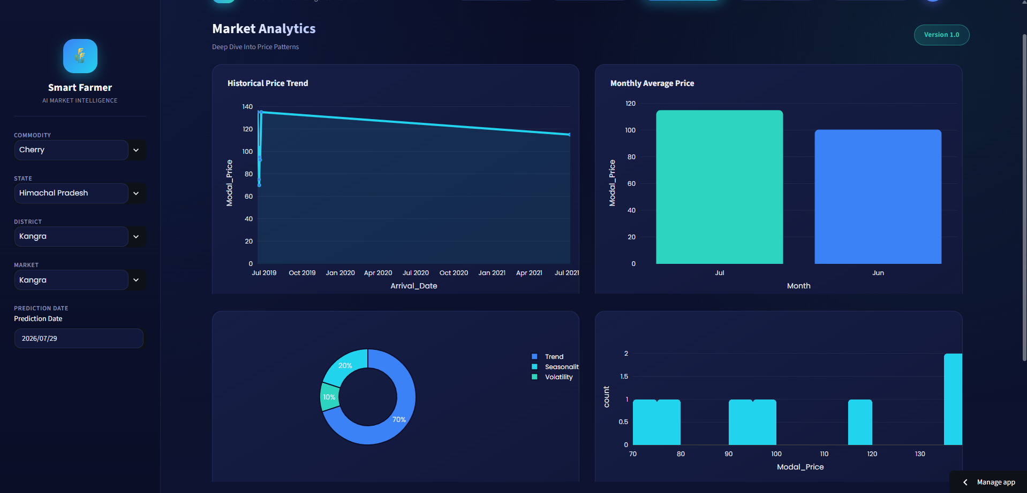
Market Analytics
📈 Historical Trend 🌦️ Seasonal Pattern ⚖️ Market Stability

Slide 13
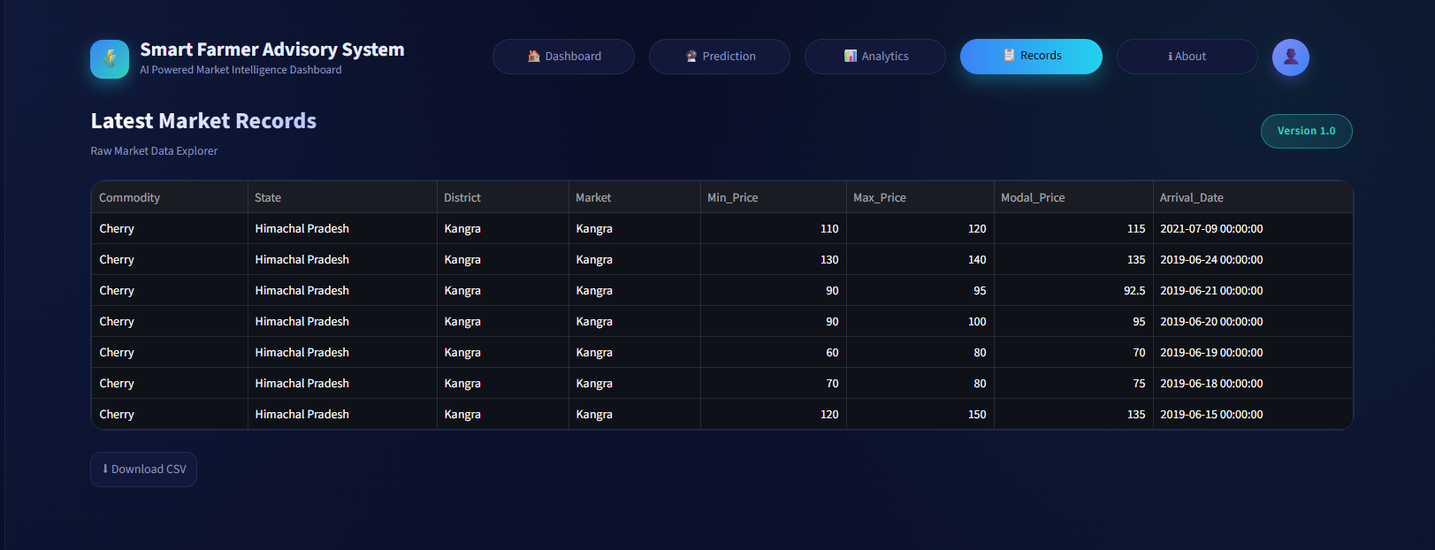
Records
Features:- 📋 Historical Records 🔍 Smart Filtering 📥 CSV Download 📊 Government Market Data

Slide 14
Future Scope
🌦️ Weather Integration
📱 Mobile Application
🌍 Multi-language Support
📩 SMS Alerts
🧠 Advanced AI Models
📊 Real-Time Market Updates

Slide 15

Questions & Discussion
🌐 Live Demo
https://smart-farmer-advisory-system.streamlit.app/
📱Scan to access the live application
💬 Happy to answer your questions

